Slide 1
A parent’s guide to Apprenticeships
Version 1.0 | Month 2022

Slide 2
What is an Apprenticeship?
Combines academic qualification with practical real work experience
At least 20% off-the-job accredited training
Last between 12-14 months (degree Apprenticeships can take longer)
Available for individuals 16 or over
Includes a formal assessment which leads to a nationally recognised qualification
Notes:
An apprenticeship is a job with training and the chance to gain qualifications. As with any job, an apprentice gets paid, but they also take part in formal on-the-job training and study for relevant qualifications linked to their role. Qualifications are paid for by the employer. Apprenticeships offer your child access to accredited training and the opportunity to develop skills and achieve a qualification whilst earning and gaining real work experience and developing business relationships, which potentially can be more advantageous than the academic qualifications offered in further education.

Slide 3
Why choose an Apprenticeship?

Slide 4
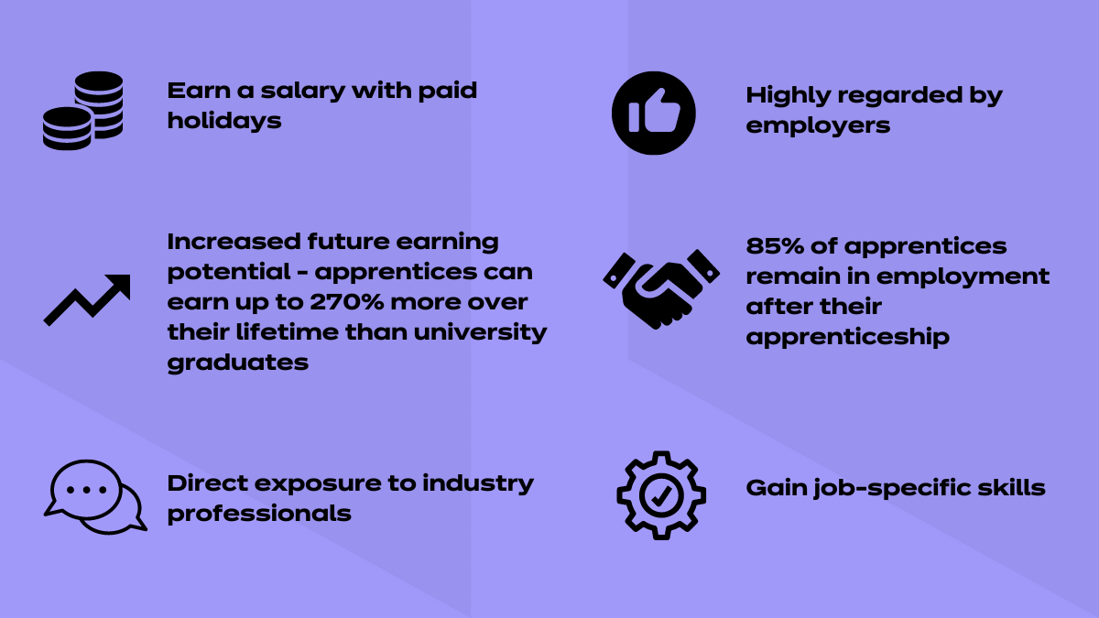
Why choose an Apprenticeship?
Notes:
An apprenticeship is a job with training and the chance to gain qualifications. As with any job, an apprentice gets paid, but they also take part in formal on-the-job training and study for relevant qualifications linked to their role. Qualifications are paid for by the employer. Apprentices do not pay anything towards their qualifications.

Slide 5
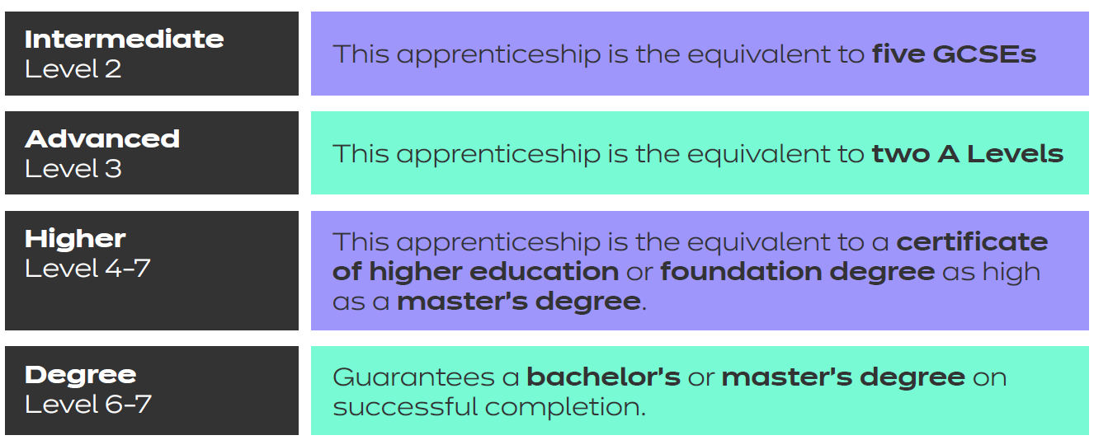
What type of Apprenticeships are there?
Notes:
Apprenticeships are available in all sorts of industries and sectors with all types of companies; some examples are: -

Slide 6
What industries can Apprenticeships offer access to?

Slide 7
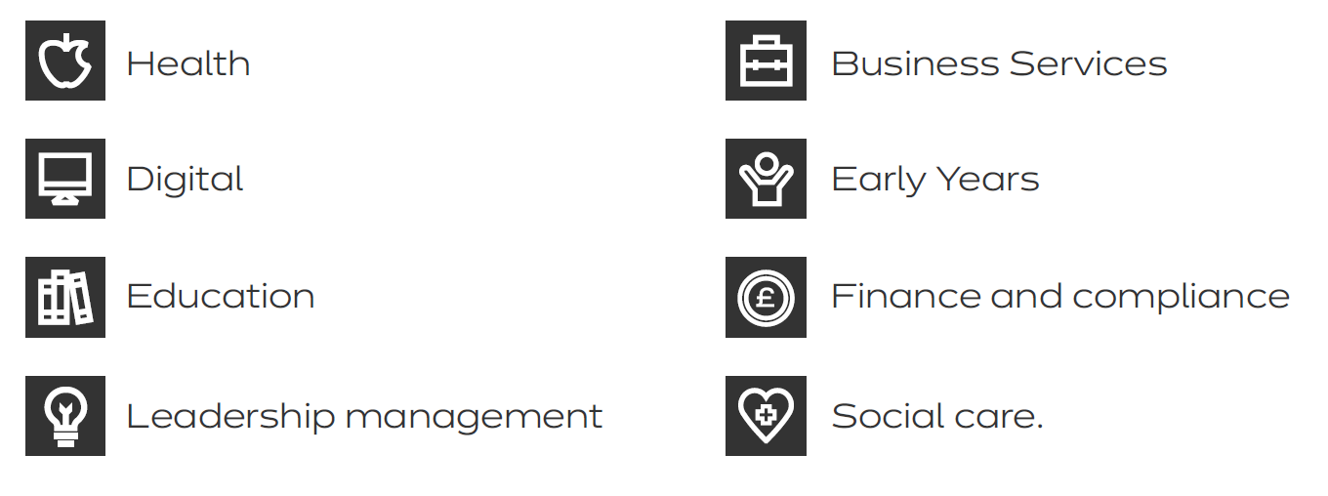
Apprenticeship industry sectors
Notes:
Apprenticeships are available in all sorts of industries and sectors with all types of companies; some examples are: -

Slide 8
What is an Apprenticeship standard?

Slide 9
Apprenticeship standards
The apprenticeship journey starts with you understanding the requirements and elements of an apprenticeship standard.
Each apprenticeship standard is made up of knowledge, skills and behaviours.
The Knowledge - during the apprenticeship you will acquire the facts, information, theory and technical information of the subject required to enable you to be effective in their role.
The Skills – the expertise, practical skills and talent needed in order to do a job, or task. The Job skills allow you to do a specific job.
Behaviours – these are the way you act, approach activities and work with others and support you to be effective in your role and future career.
Notes:
The apprenticeship journey starts with you understanding the requirements and elements of an apprenticeship standard.
Each apprenticeship standard is made up of knowledge, skills and behaviours.

Slide 10
Starting on the road to success

Slide 11
Starting your Apprenticeship
Initial Assessment-Completion of an initial assessment to determine correct apprenticeship route and to identify if you need support in developing your English and maths skills.
Skills Test– An opportunity to demonstrate your understanding of the role and to share your current knowledge and skills.
Skills Scan– completion of a skills scan to identify current skills and any skills gap requirements.
Notes:
It’s really important to get a good start to your apprenticeship. This is an opportunity to see if the apprenticeship route is right for you, to have support to map out your career path and career choices and to determine the right apprenticeship and the right level. MTD call this part of the Apprenticeship the Initial Engagement. As part the Initial Engagement stage you will undertake and complete:

Slide 12
Gateway and End Point Assessment explained

Slide 13
Gateway and End Point Assessment
When the apprentice has completed their formative training, there will be a short period of time where the Employer, Training Provider and apprentice will assess the apprentice’s progress. The Employer will then determine whether or not the Apprentice is ready to take on the End-Point Assessment.
Generally, the Gateway stage is where all aspects of the apprenticeship must be completed.
Notes:
Gateway
When the apprentice has completed their formative training, there will be a short period of time where the Employer, Training Provider and apprentice will assess the apprentice’s progress. The Employer will then determine whether or not the Apprentice is ready to take on the End-Point Assessment.
Generally, the Gateway stage is where all aspects of the apprenticeship must be completed. These could include:
Any on-programme qualifications, including Functional Skills
Any finalised projects, such as portfolios or projects
Any other requirements outlined in the Apprenticeship Standard
For some apprenticeships, there will need to be a meeting between parties involved in the apprenticeship to determine how and when the assessment process will unfold.
End Point Assessment
Towards the end of an apprenticeship, the Employer and Training Provider will begin preparing the apprentice for the End-Point Assessment. The schedule for all the assessments will be determined by the End-Point Assessor, who is hired by the EPAO.
End-Point Assessment is made up of a number of assessment elements which the apprentice must pass in order to complete the apprenticeship.
These assessments are designed to give the apprentice the opportunity to demonstrate all the required knowledge, skills and behaviours outlined in the Apprenticeship Standard. These are the criteria required for them to be fully competent in their role.
During the assessment period, the apprentice will undergo several assessments over a set period of time, which will be led and graded by the End-Point Assessor.
Search for your Apprenticeship Standard on the Institute for Apprenticeships and Technical Education website to find out the requirements of the apprenticeship and what the apprentice will accomplish through their programme.

Slide 14
Where to go to find out more and apply

Slide 15
Notes:
There’s a host of sources where you can find really valuable information to support you in understanding if an apprenticeship could be the right choice for you or for someone you care for.
Once you’ve made your decision you can visit

